Slide 1
Writing a Hackathon App In Golang

Slide 2
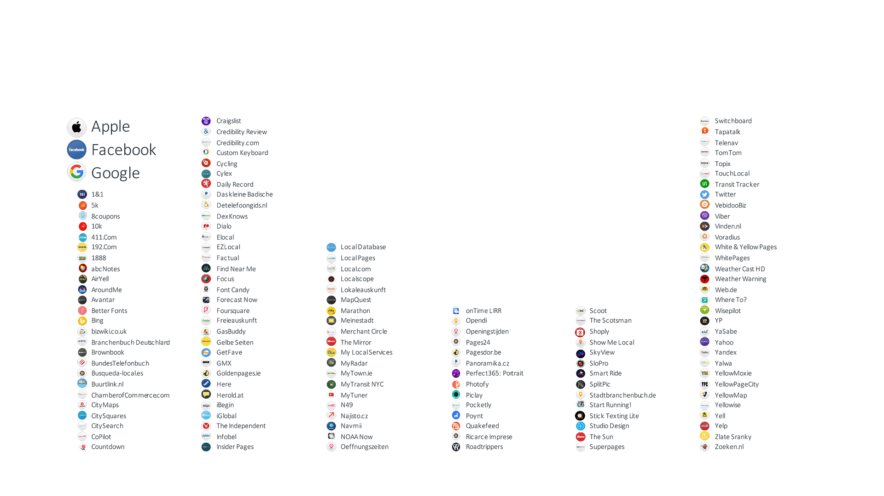
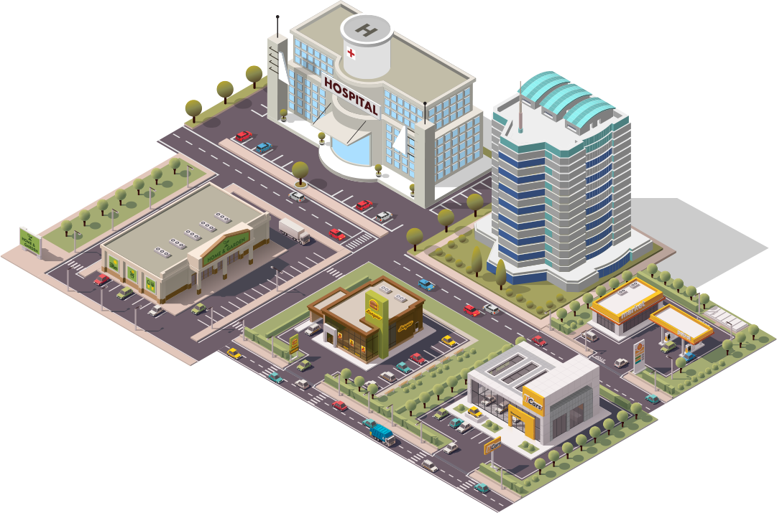
#1 Location Management Platform & Ecosystem
Notes:
Sponsored slide for people who do not know about Yext. Briefly talk about it.

Slide 3
Building A Winning Hackathon Project
Find partners
Grab all the free swag
Come up with a cool idea
(attend this tech talk)
Code all night
Eat free food
Profit???

Slide 4
Talk Objective
Create a simple Todo app with Golang and
Create, Read, Update, Delete Todo cards
Introduce Golang
Structure of the project
Creating a RESTful API in Golang (optimized for hackathons)
Bonus: go over frontend code

Slide 5
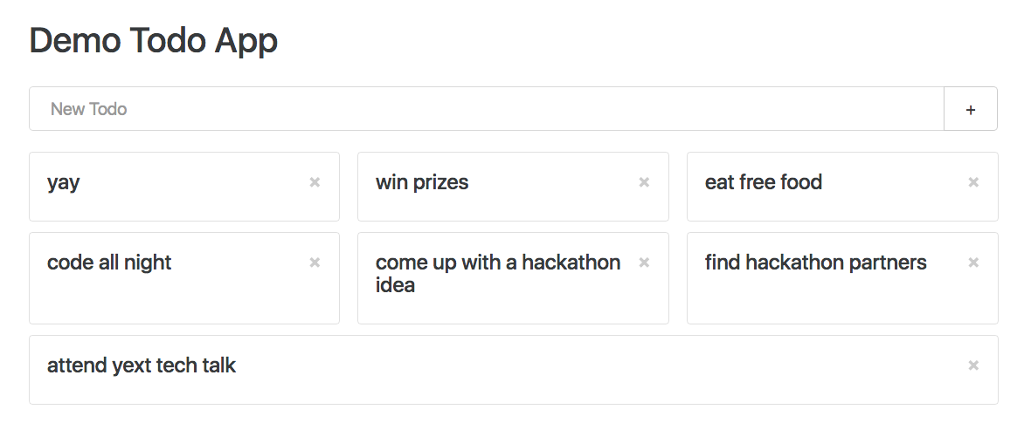
Preview

Slide 6
Assumed Knowledge
To get the most out of the talk, best to know:
At least one programming language
Familiar with pointers
Preferably familiar with C-style languages or Python
Familiar with APIs

Slide 7

What is Golang?
Also known as Go, Golang is
A free open source programming language created at Google
Compiled
Statically typed
Garbage collected

Slide 8
Why Use Go?
Productive and readable
Fast compilation
Fast execution
Great built in tooling
Native support for networking and multiprocessing

Slide 9
Go At Yext
At Yext, we use Go for
Webservices
Microservices
Continuous Integration
Error alerting
Managing local microservice instances

Slide 10
Hello World Webservice
Server.go
package main
import (
"fmt"
"log"
"net/http"
)
func main() {
http.HandleFunc("/", func(w http.ResponseWriter, r *http.Request) {
fmt.Fprintf(w, "hello world")
})
log.Fatal(http.ListenAndServe(":8000", nil))
}

Slide 11
Running Hello World Webservice
After you have installed Go (golang.org):
See golang.org/doc/code.html to set up workspace
Create server.go
In command line: go run server.go
Go to localhost:8000 in your browser

Slide 12
Handling Multiple Routes
Handling multiple routes with net/http is annoying
Solution: use gorilla/mux library (github.com/gorilla/mux)
Installing: go get -u gorilla/mux
Objective: Create webservice with 2 routes
/index1 - displays “hello world 1”
/index2 - displays “hello world 2”

Slide 13
Hello World Webservice With gorilla/mux Library
Server.go
package main
import (
// other imports
"github.com/gorilla/mux"
)
func Index1(w http.ResponseWriter, r *http.Request) { fmt.Fprintf(w, "hello world 1") }
func Index2(w http.ResponseWriter, r *http.Request) { fmt.Fprintf(w, "hello world 2") }
func main() {
router := mux.NewRouter().StrictSlash(true)
router.HandleFunc("/index1", Index1)
router.HandleFunc("/index2", Index2)
log.Fatal(http.ListenAndServe(":8000", router))
}

Slide 14

Structuring Our Application
Use MVC (Model-View-Controller) design pattern
Application structure
controller/
todo.go
model/
todo.go
server.go
todo.json
Notes:
Now that we have a basic web server set up, think about how to structure app

Slide 15
Structuring Our Application Model
Model
Will represent the Todo items
Usually backed by a database (annoying to set up)
For hackathons, use a JSON file
Maintain a global variable of all the Todo items
Model code will go in model/todo.go

Slide 16
Model Code
package model
type Todo struct {
Id int `json:"id"`
Name string `json:"name"`
}
type Todos struct {
NextId int `json:"nextId"`
// Data is of type slice of pointers to Todo, keep Todos inside Data sorted by Id
Data []*Todo `json:"data"`
}
// global variable of Todos, will be serialized to and from JSON
var todos Todos

Slide 17
What Is a Slice?
An array has a fixed size and length
Example array in Go:
primes := [6]int{2, 3, 5, 7, 11, 13}
// note: “:=” is a declaration and assignment
Slice: dynamically sized flexible view into the elements of an array
Declaring and assigning a slice
var s []int = primes[1:4] // printing s gives [3, 5, 7]

Slide 18
Model JSON Serialization And Deserialization
// todo.json
{
"nextId": 0,
"data": []
}
// model/todo.go
func LoadTodos() error {
file, err := ioutil.ReadFile(todosFile)
if err != nil {
return err
}
return json.Unmarshal(file, &todos)
}
// model/todo.go
const (
todosFile = "./todos.json"
wrrPerm = 0644
)
func saveTodos() error {
b, err := json.Marshal(todos)
if err != nil {
return err
}
return ioutil.WriteFile(todosFile, b, wrrPerm)
}

Slide 19
Create and List Operations For Model
// Multiple return values!
func CreateTodo(name string) (*Todo, error) {
todo := &Todo{
Id: todos.NextId,
Name: name,
}
todos.NextId++
todos.Data = append(todos.Data, todo)
if err := saveTodos(); err != nil {
return nil, err
}
return todo, nil
}
func ListTodos() []*Todo {
return todos.Data
}

Slide 20
Update and Delete Operations For Model
func UpdateTodo(todo *Todo) error {
// findTodoIndex is a user defined function
// finds the Todo with the given id
// and returns the index it is at in the Data slice
idx := findTodoIndex(todo.Id)
if idx == -1 {
return errors.New(fmt.Sprintf(
"Could not find todo with id: %d", todo.Id))
}
todos.Data[idx] = todo
return saveTodos()
}
func DeleteTodo(id int) error {
idx := findTodoIndex(id)
if idx == -1 {
return errors.New(fmt.Sprintf(
"Could not find todo with id: %d", id))
}
// removes a single Todo from the slice
todos.Data = append(
todos.Data[:idx], todos.Data[idx+1:]...)
return saveTodos()
}
Notes:
Now that we have a basic web server set up, think about how to structure app

Slide 21
Structuring Our Application Controller
Controller
Will be used to perform operations on the Todo items
CRUD (Create, Read, Update, Delete)
Create API endpoints for CRUD operations
Accept JSON as input and output JSON
Use the model CRUD operations
Controller code will go in controller/todo.go
Notes:
Now that we have a basic web server set up, think about how to structure app

Slide 22
Create and List Operations For Controller
func TodoCreate(w http.ResponseWriter, r *http.Request) {
var data struct {
Name string `json:"name"`
}
err := json.NewDecoder(r.Body).Decode(&data)
// check error is a user defined function
if checkError(w, err) { return }
todo, err := model.CreateTodo(data.Name)
if checkError(w, err) { return }
jsonResponse(w, todo)
}
func TodosList(w http.ResponseWriter, r *http.Request) {
// anonymous structs
data := struct {
Data []*model.Todo `json:"data"`
}{
Data: model.ListTodos(),
}
// jsonResponse is a user defined function
// that serializes data to json
jsonResponse(w, data)
}
Notes:
Now that we have a basic web server set up, think about how to structure app

Slide 23
Update and Delete Operations For Controller
func TodoUpdate(w http.ResponseWriter, r *http.Request) {
var todo model.Todo
err := json.NewDecoder(r.Body).Decode(&todo)
if checkError(w, err) {
return
}
err = model.UpdateTodo(&todo)
checkError(w, err)
}
func TodoDelete(w http.ResponseWriter, r *http.Request) {
vars := mux.Vars(r)
idString := vars["id"]
id, err := strconv.Atoi(idString)
if checkError(w, err) {
return
}
if checkError(w, model.DeleteTodo(id)) {
return
}
w.WriteHeader(http.StatusOK)
}
Notes:
Now that we have a basic web server set up, think about how to structure app

Slide 24
Setting Up Api Endpoints In server.go
func main() {
if err := model.LoadTodos(); err != nil {
log.Fatal("Could not load todos from file ", err)
}
r := mux.NewRouter().StrictSlash(true)
r.HandleFunc("/todos", controller.TodoCreate).Methods("POST")
r.HandleFunc("/todos", controller.TodosList).Methods("GET")
r.HandleFunc("/todos", controller.TodoUpdate).Methods("PUT")
r.HandleFunc("/todos/{id}", controller.TodoDelete).Methods("DELETE")
http.Handle("/", r)
log.Fatal(http.ListenAndServe(":8000", nil))
// CRUD operations should now work!
}

Slide 25
Bonus: Add Mutex Locking For Concurrency Safety
type Todos struct {
sync.RWMutex
NextId int `json:"nextId"`
Data []*Todo `json:"data"`
}
func CreateTodo(name string) (*Todo, error) {
todos.Lock()
defer todos.Unlock()
… rest of create code
}
func ListTodos() []*Todo {
todos.RLock()
defer todos.RUnlock()
return todos.Data
}
func UpdateTodo(todo *Todo) error {
todos.Lock()
defer todos.Unlock()
// … rest of update code
}
func DeleteTodo(id int) error {
todos.Lock()
defer todos.Unlock()
// … rest of delete code
}
Notes:
Now that we have a basic web server set up, think about how to structure app

Slide 26
Bonus: Frontend
Use Bootstrap 4 and jQuery
New directory, layout:
model/
controller/
static/
server.go
todo.json
static directory layout:
static/
css/
main.css
js/
todo.js
index.html
Notes:
Now that we have a basic web server set up, think about how to structure app

Slide 27
Updated For Frontend server.go
func main() {
if err := model.LoadTodos(); err != nil { log.Fatal("Could not load todos from file ", err) }
r := mux.NewRouter().StrictSlash(true)
r.HandleFunc("/todos", controller.TodoCreate).Methods("POST")
r.HandleFunc("/todos", controller.TodosList).Methods("GET")
r.HandleFunc("/todos", controller.TodoUpdate).Methods("PUT")
r.HandleFunc("/todos/{id}", controller.TodoDelete).Methods("DELETE")
r.HandleFunc("/", controller.Index).Methods("GET") // serves index.html
r.PathPrefix("/static").Handler(http.FileServer(http.Dir("./"))) // serves all the static assets
http.Handle("/", r)
log.Fatal(http.ListenAndServe(":8000", nil))
}

Slide 28
Frontend Javascript Controller
Controller calls server.go API endpoints using AJAX, updates view
var createCard = function(todo) { … }
var listCards = function() { … }
var updateCard = function(todo) { … }
var deleteCard = function(todoId) { … }
Notes:
Now that we have a basic web server set up, think about how to structure app

Slide 29
Frontend Javascript Update View Functions
Controller calls server.go API endpoints using AJAX, updates view
var getCardHtml = function(todo) { … } // single card
var getCardDeckHtml = function(cardsHtml) { … } // row of cards
var renderCards = function() { … } // renders all the cards
Notes:
Now that we have a basic web server set up, think about how to structure app

Slide 30
Get The Code!
github.com/harrisonzhao/simple-golang-webapp
(you might need to fix some of the import paths)

Slide 31
Thank You!

